Slide 1

Autowastagator
Presented by,
Team Adanistas :
Sonali Preetha Nandagopalan
Silpa S
Prakriti Sharma K P
Students of Information Science and Engineering Department(ISE)

Slide 2
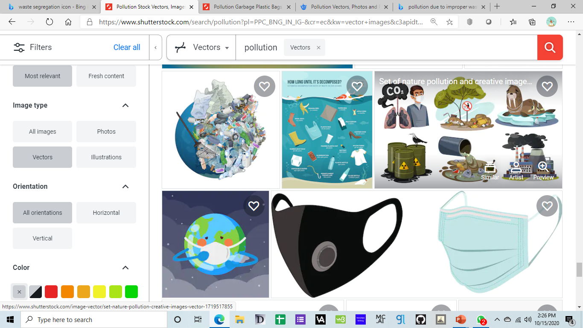
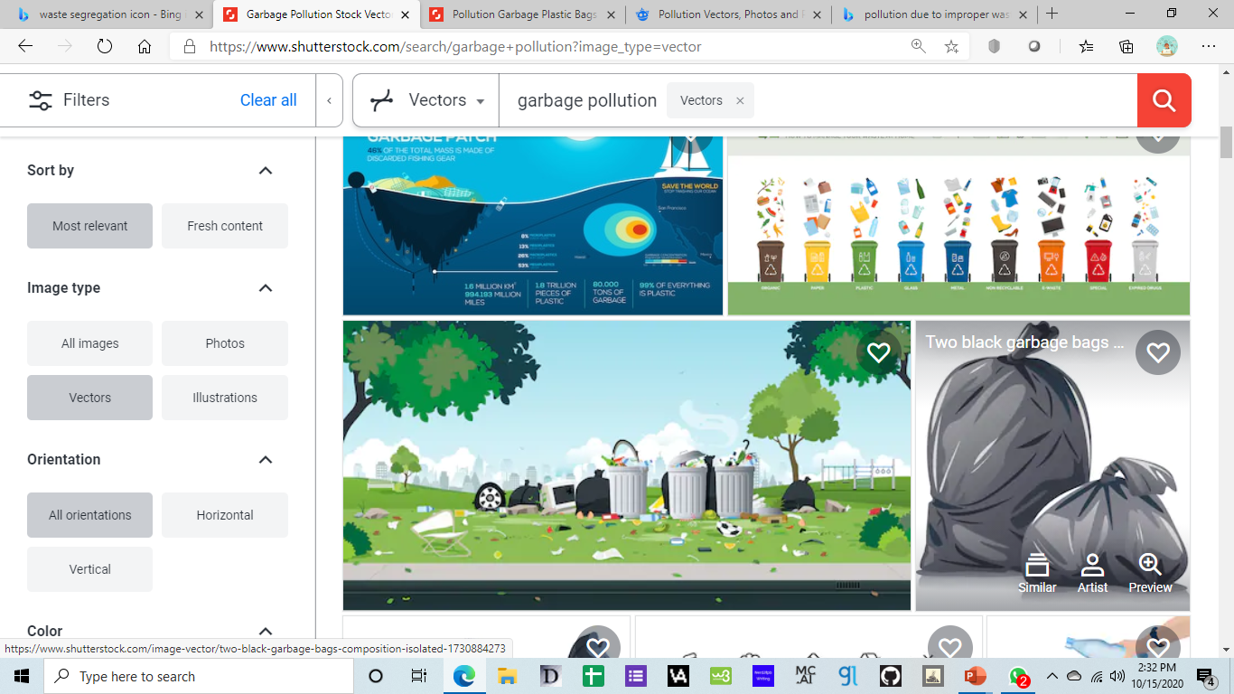
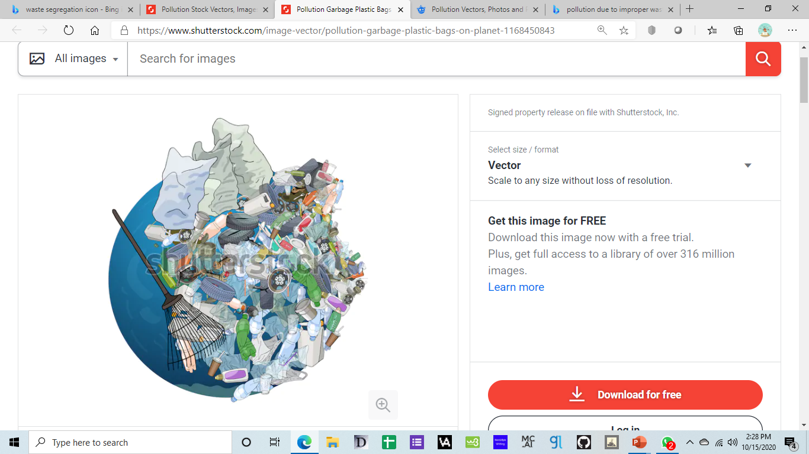
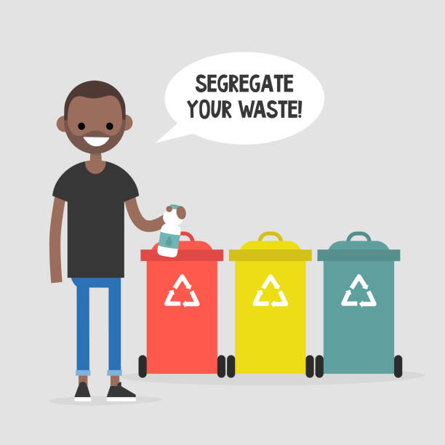

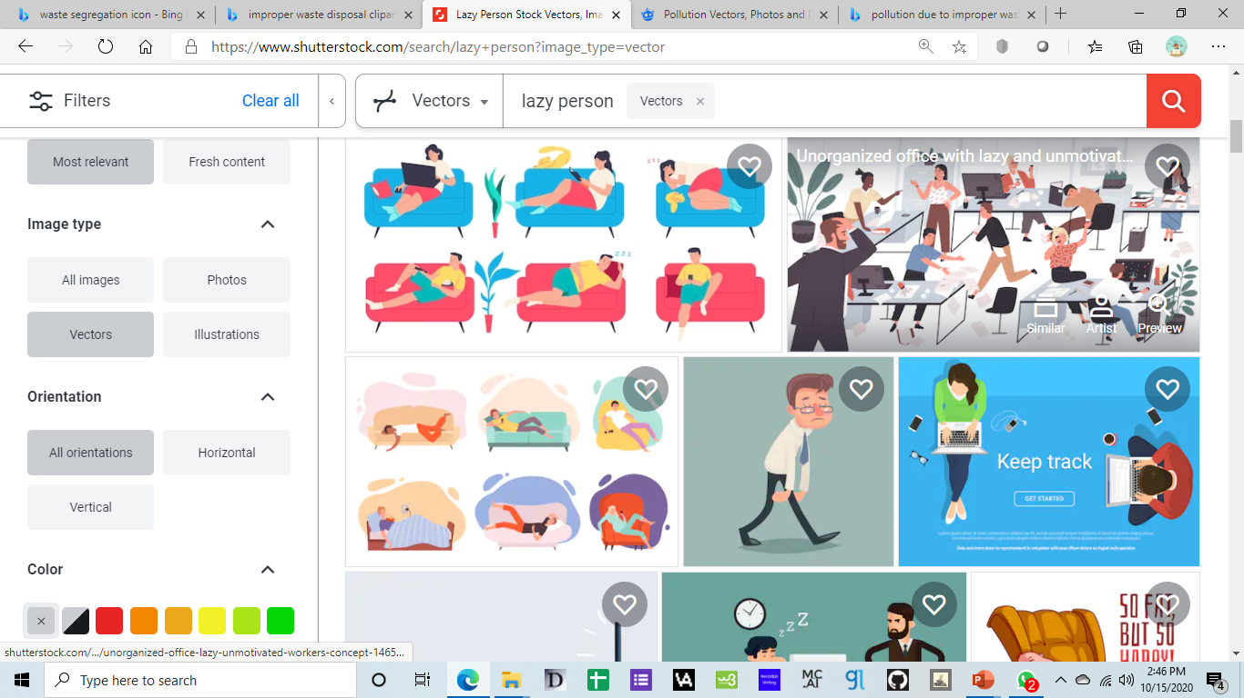
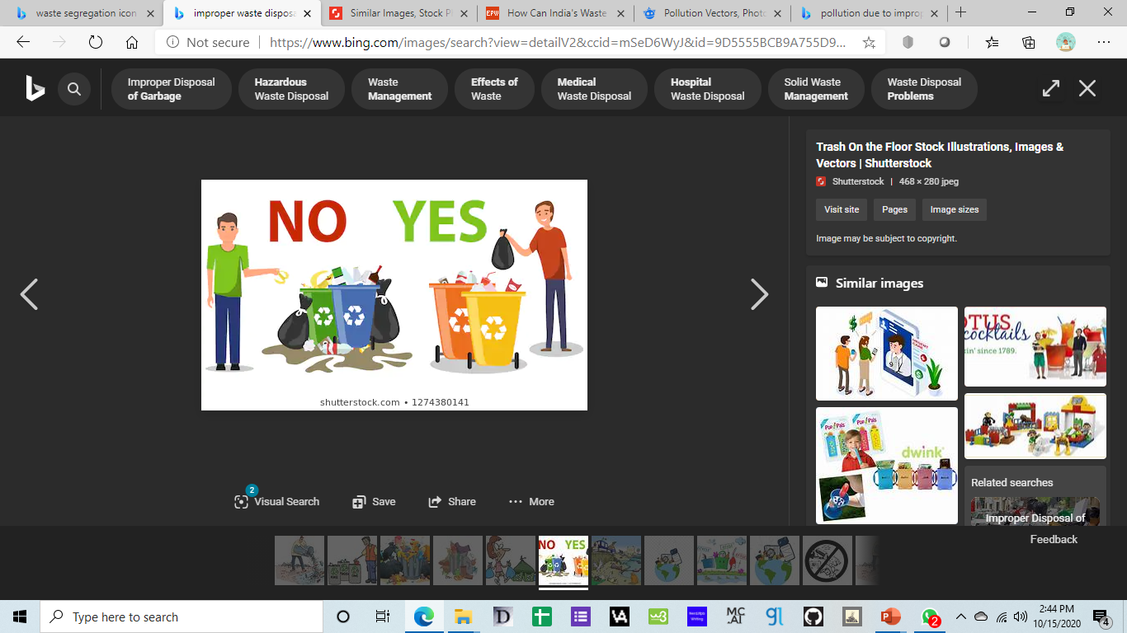
PROBLEM STATEMENT

Slide 3
Problem Statement
Waste Segregation
This concept and its benefits were explained and promoted. People knew now that separating the waste into categories could help us do our share in saving the world.
Environment degrading over the years
The environment has degraded a lot in the past decade and improper waste management has a big role to play in it.
Awareness Campaigns
People started segregating waste, thanks to these campaigns. Slowly, waste segregation became mandatory in places, and it was starting to become a part of the lifestyle.
Giving in
When people were busy, or tired, the environment didn’t seem so important to humans anymore. Hence a solution has to be found!

Slide 4
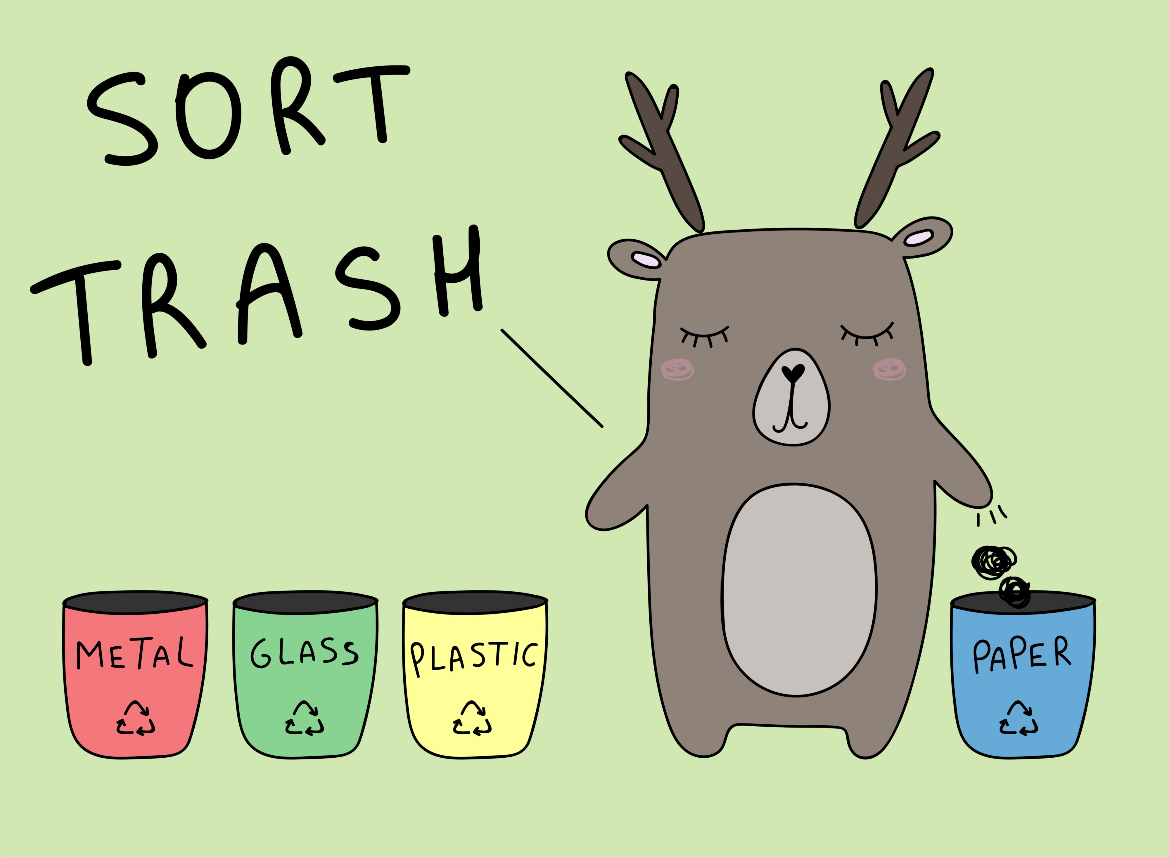
PROPOSED SYSTEM
AUTOWASTAGATOR!
A model that segregates wet, dry and plastic waste automatically!

Slide 5
Tech Parks
Colleges
Target users
Other Large Organisations

Slide 6
FLOWCHART
Video Stream as input
Predictions are made on the frames of the video by the model
A waste classification report is generated with the prediction results
The video is split up into frames
The report is then mailed to the user/organisation.

Slide 7






Technology Stack
TKinter

Slide 8
Dataset Sources
Thung and Mindy Yang’s (TrashNet) Dataset
Kaggle Waste Classification Images
Total of approximately 26,000 images!

Slide 9
What Sets Us Apart?
Accuracy
71%
Waste Classification Report
Analysis of data to impose safe disposal of trash
Automation of Waste segregation
Trash can be automatically segregated with very less human intervention!

Slide 10
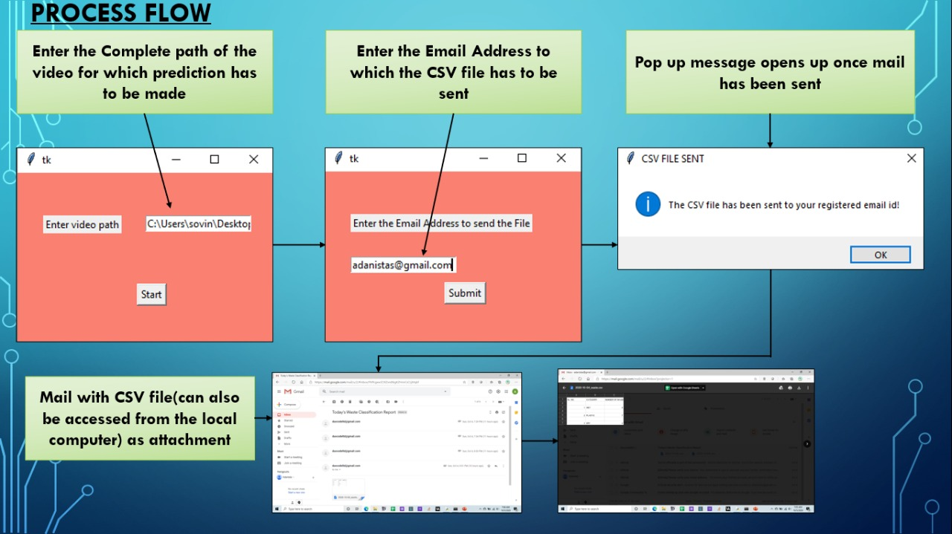
Demonstation of Project

Slide 11
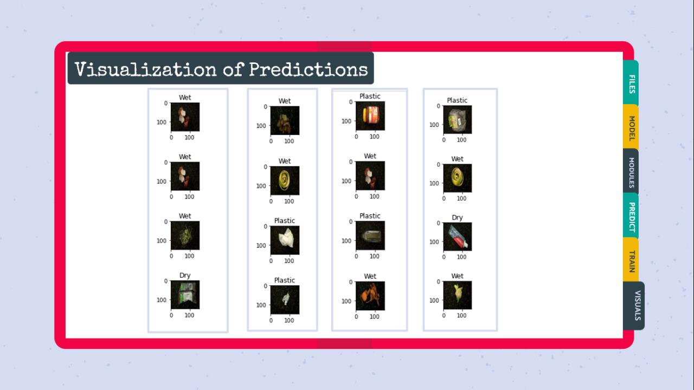
Visualisation of Predictions
As we can see, our model got all 16/16 predictions right!

Slide 12
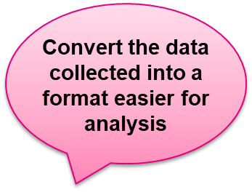
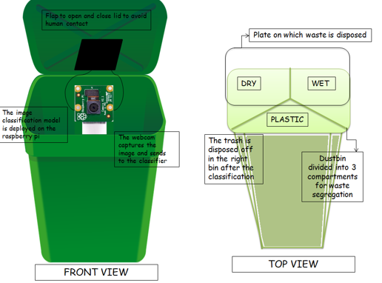
Future Implementation
Real time waste segregation process

Slide 13
Raspberry Pi board
Our model can be deployed onto the board to automate the dustbin
Real time classification
Instead of a video input, the model can be developed to work on real-time feed from camera
Data format
The data can be converted into formats for easier analysis
Future Implementation

Slide 14
Link to our GitHub repository:
https://github.com/Sonali2824/AUTOMATIC-WASTE-SEGREGATOR

Slide 15
Link to our Instructions and Guide:
https://drive.google.com/file/d/1NkXdsCRu6NgmVau9nOVZkz-BKu4ltk7D/view?usp=sharing

Slide 16
Link to our video with respect to the project:
https://drive.google.com/file/d/1t1j0kn3CWUSTD1A_iWmT14-93GGKXwMj/view?usp=sharing

Slide 17
Meet the Team
Sonali Preetha Nandagopalan
Number: +91 9986682692
E-mail: sovinara2824@gmail.com
College: New Horizon College of Engineering
Silpa S
Number: +91 8197593286
E-mail: silpasreeni99@gmail.com
College: New Horizon College of Engineering
Prakriti Sharma K P
Number: +91 8884245952
E-mail: prakriti.s777@gmail.com
College: New Horizon College of Engineering

Slide 18
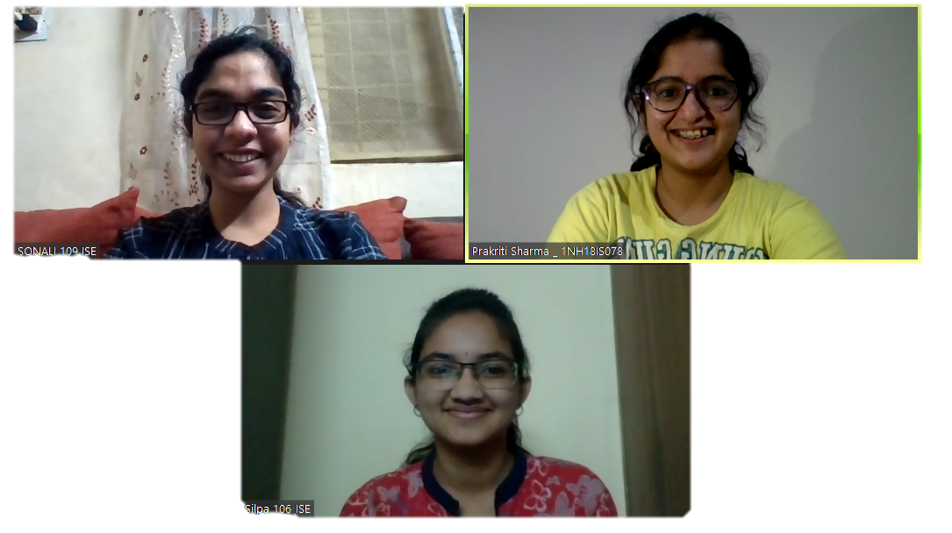
Virtual Selfie

Slide 19
Thank you!

